Slide 1


CHAPTER 1
Introduction to Research
DISCOVER . LEARN . EMPOWER

Slide 2
INDEX
Research methods vs Methodology
Criteria of good research
Steps of Research Process

Slide 3
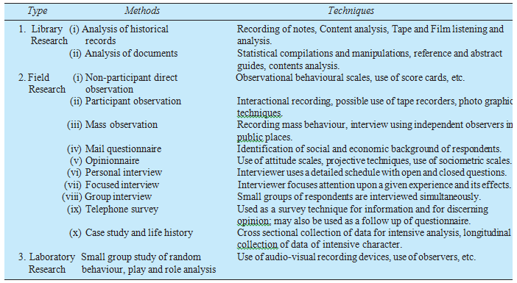
Research methods vs Methodology

Slide 4
Criteria of good research
1. The purpose of the research should be clearly defined and common concepts be used.
2. The research procedure used should be described in sufficient detail to permit another researcher to repeat the research for further advancement, keeping the continuity of what has already been attained.
3. The procedural design of the research should be carefully planned to yield results that are as objective as possible.
4. The researcher should report with complete frankness, flaws in procedural design and estimate their effects upon the findings.
5. The analysis of data should be sufficiently adequate to reveal its significance and the methods of analysis used should be appropriate. The validity and reliability of the data should be checked carefully.
6. Conclusions should be confined to those justified by the data of the research and limited to those for which the data provide an adequate basis.
7. Greater confidence in research is warranted if the researcher is experienced, has a good reputation in research and is a person of integrity.

Slide 5
Criteria of good research
Good research is systematic
Good research is logical
Good research is empirical
Good research is replicable

Slide 6
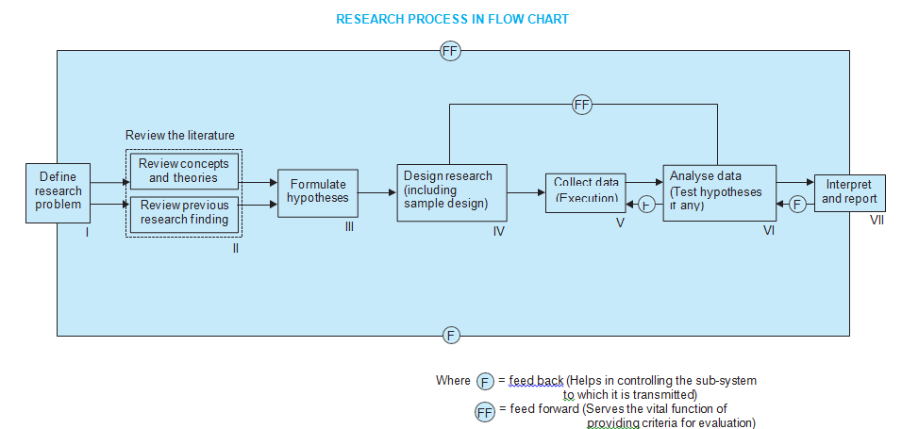

Slide 7
Steps of Research Process
(1) Formulating the research problem;
(2) Extensive literature survey; (3) Developing the hypothesis;
(4) Preparing the research design;
(5) Determining sample design;
(6) Collecting the data;
(7) Execution of the project;
(8) Analysis of data;
(9) Hypothesis testing;
(10) Generalizations and interpretation,
(11) Preparation of the report or presentation of the results, i.e., formal write-up of conclusions reached.

